Slide 1
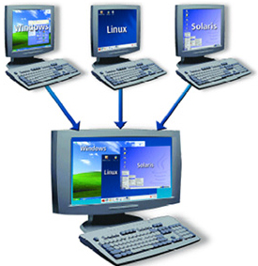
LINUX – THE LINUX FILE SYSTEM PART 3
Docente: Dott. Daniele Gobbo Modulo 3

Slide 2
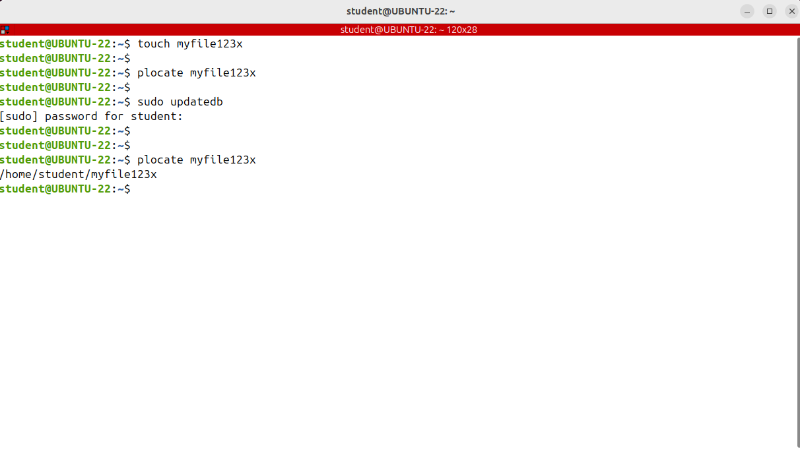
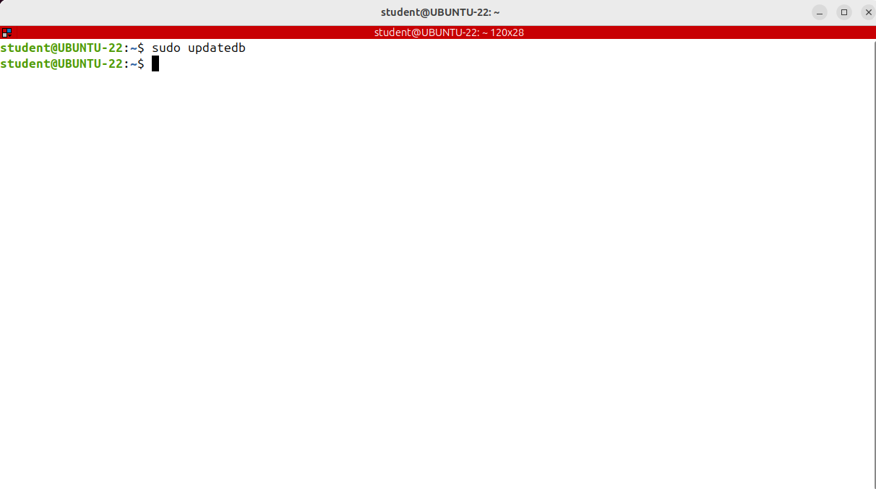
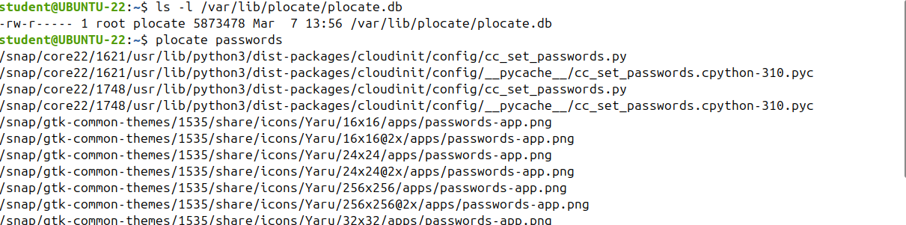
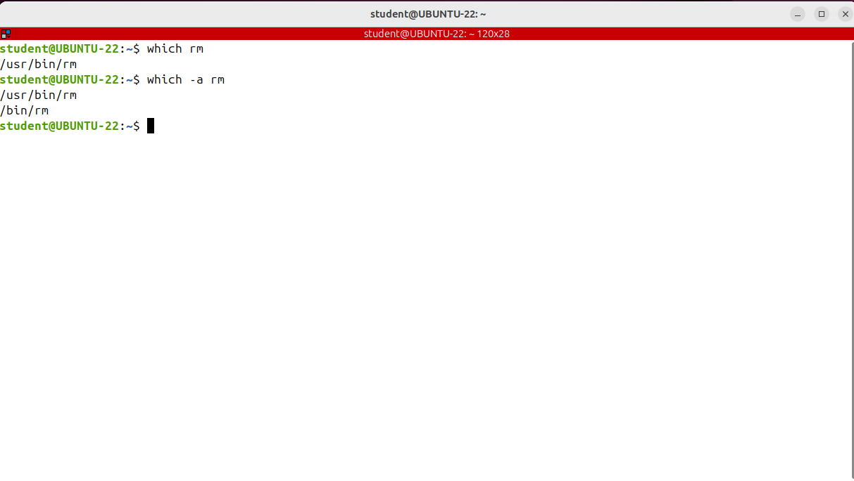
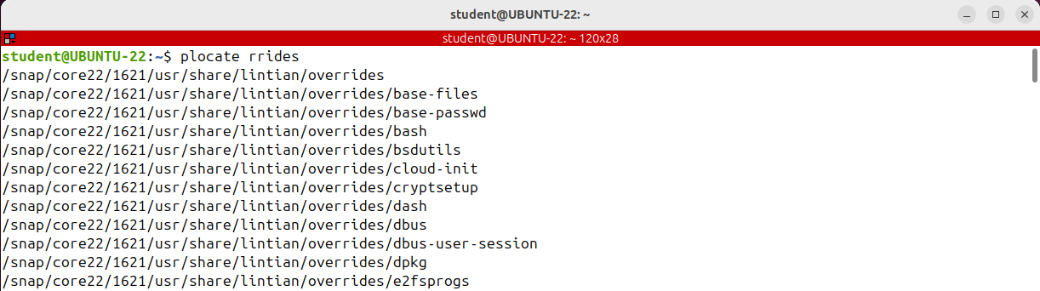
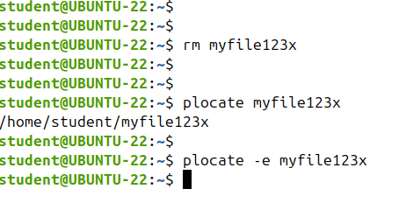
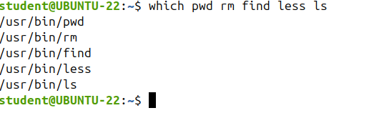
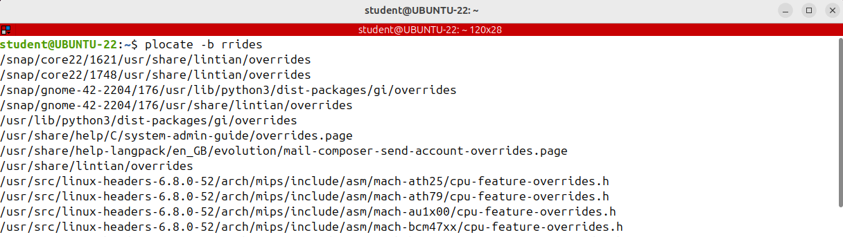
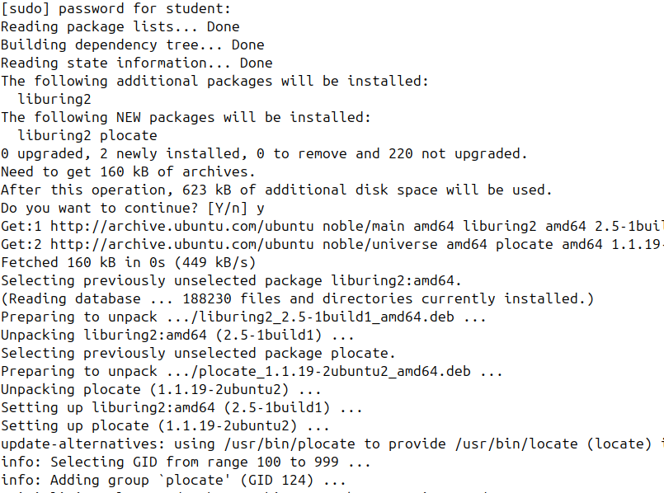
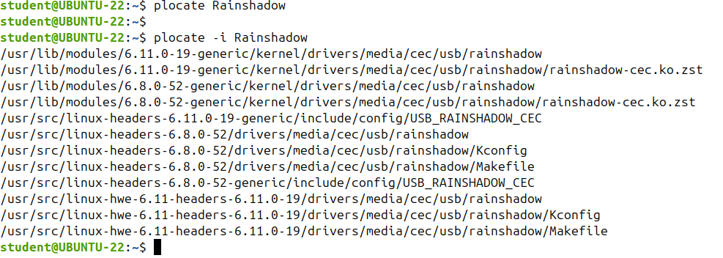
Finding Files and Directories - Part 1 (which, plocate)
Linux is a file centric operating system, and finding files and directories is a common administrative task.
The database created by update DB that will be searched by locate command is this file var lib p locate.
only displays the first matching executable
Pay attention that it searches for the string in the entire absolute path.
plocate is faster than find because it doesn't search in the file system in real time.
plocate uses a pre-built database where the find command searches in the real system through all the actual directories and files.
the find command has more options available.
The database used by placate should be updated periodically.
It can be done automatically on a daily basis from cron, or you can do it manually by running update db as root.
display all matching executables if there are more.
This can be particularly useful for determining which version of a command is being executed if multiple
to search matches only in the final component of the file name you must use –b option
Let's go ahead and talk about the p.locate and find commands which are used to find files on disk.
On ubuntu you have to install it by running apt install locate.

Slide 3
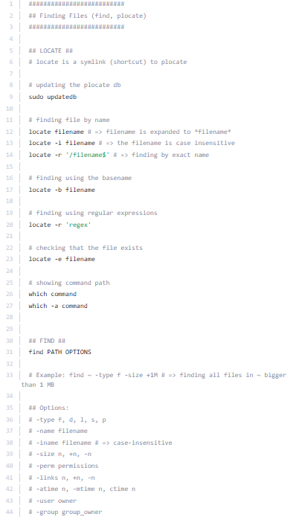
Finding Files and Directories - Part 1 (which, plocate)

Slide 4
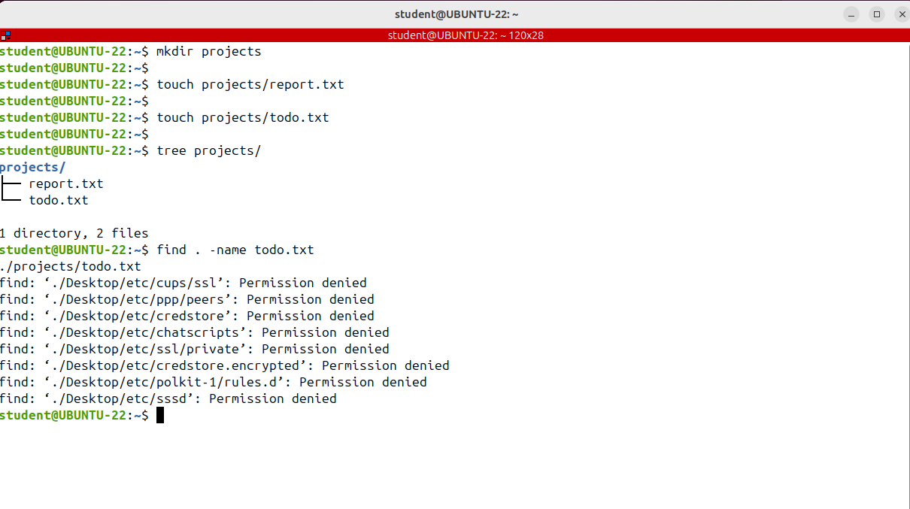
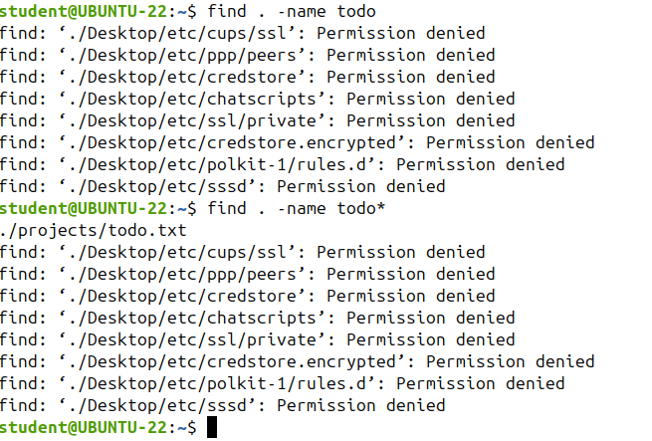
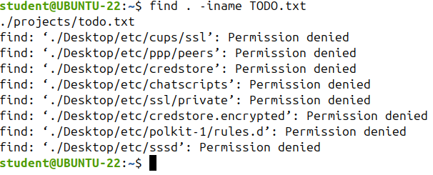
Finding Files and Directories - Part 2 (find)
The locate come in used to search for files and directories is very fast, but has two major drawbacks.
It has only a few options and most importantly, it doesn't do real time search of the file system, but of its own database file, which should be constantly updated.
And other Linux command used to search for files is find.
It's a complex command line utility that searches for files in a directory and recursively throw subdirectories as well.
Using find, you can search for files by name, owner, group type, permissions , date and other criteria.
This will delete the file with no possibility of recovering it.

Slide 5
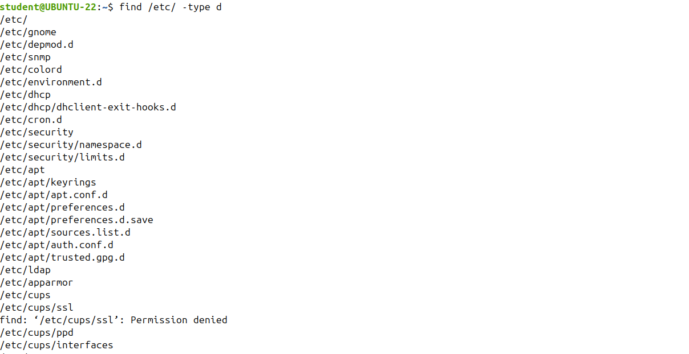
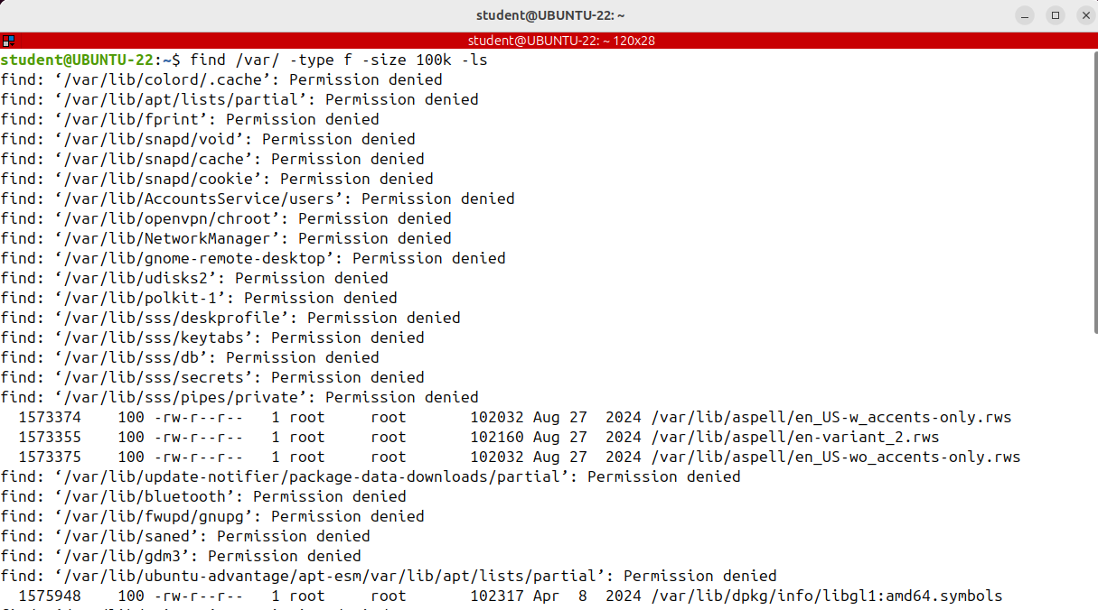
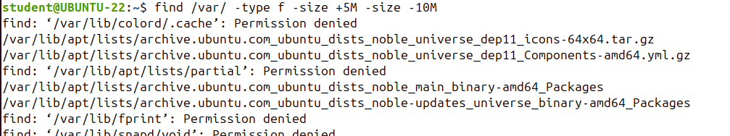
Finding Files and Directories - Part 2 (find)
how to search files by type and for that there is the -type option

Slide 6
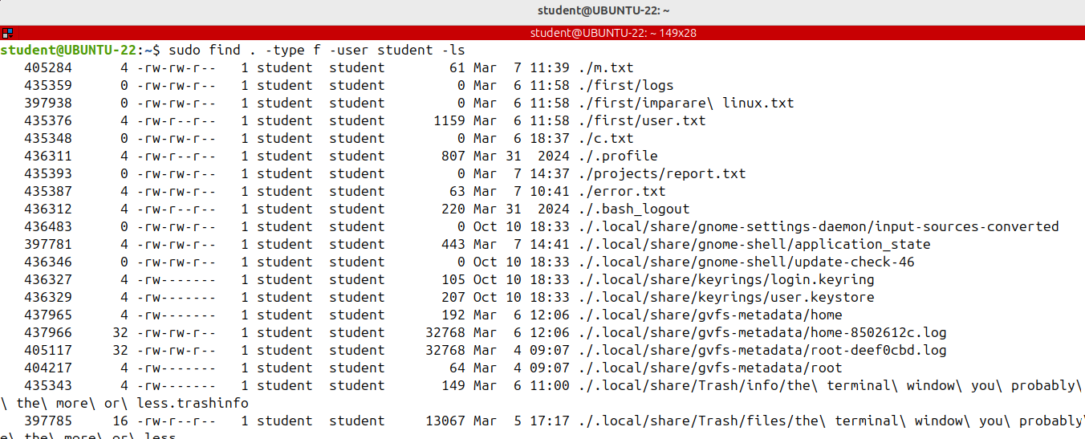
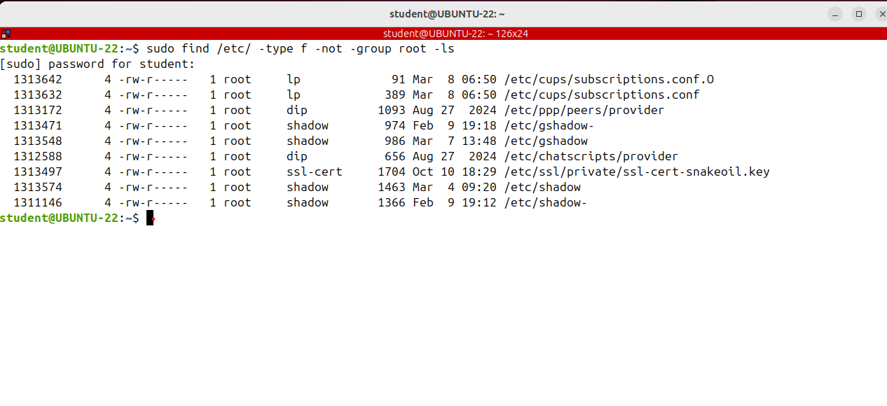
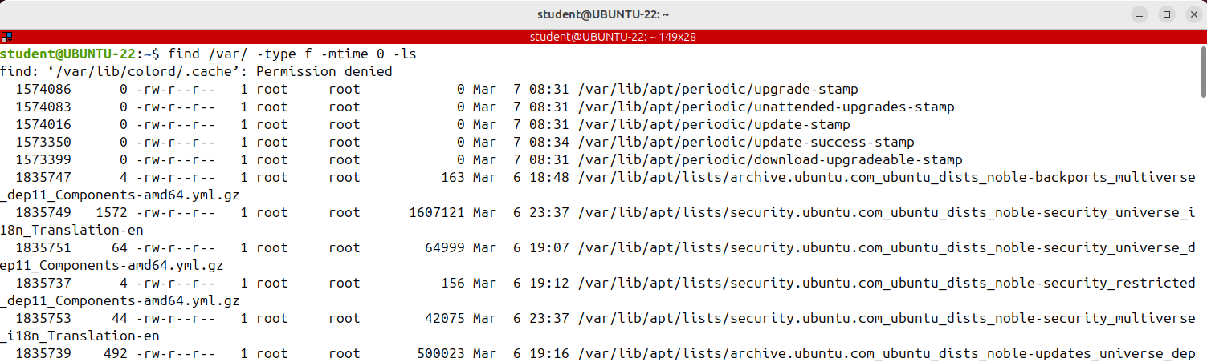
Finding Files and Directories - Part 2 (find)
How to search by time, acsess time, modification time or change time.
To search
by timestamps recorded on the files, used the
-atime, -mtime or -ctime options and
the number that represents the number of days.
These are the files modified in the last 24 hours.

Slide 7
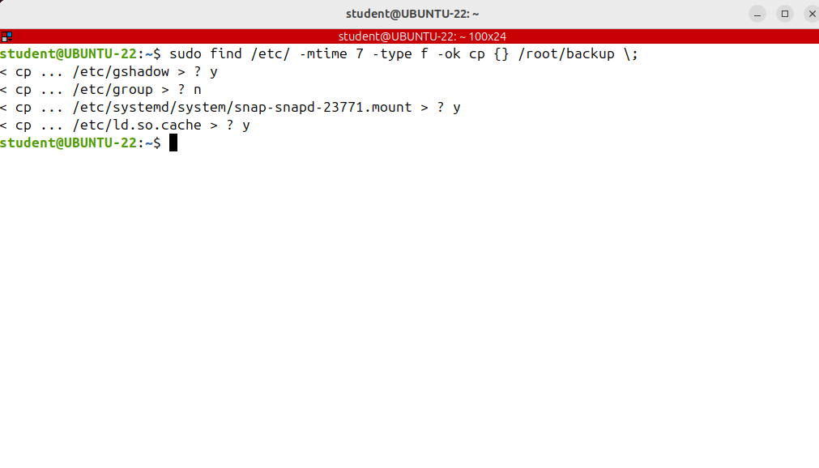
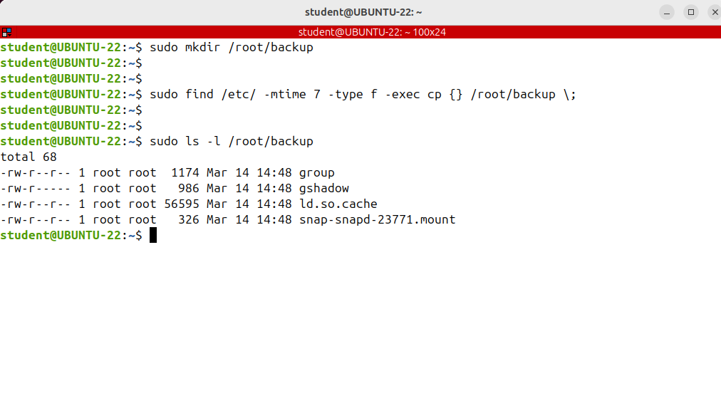
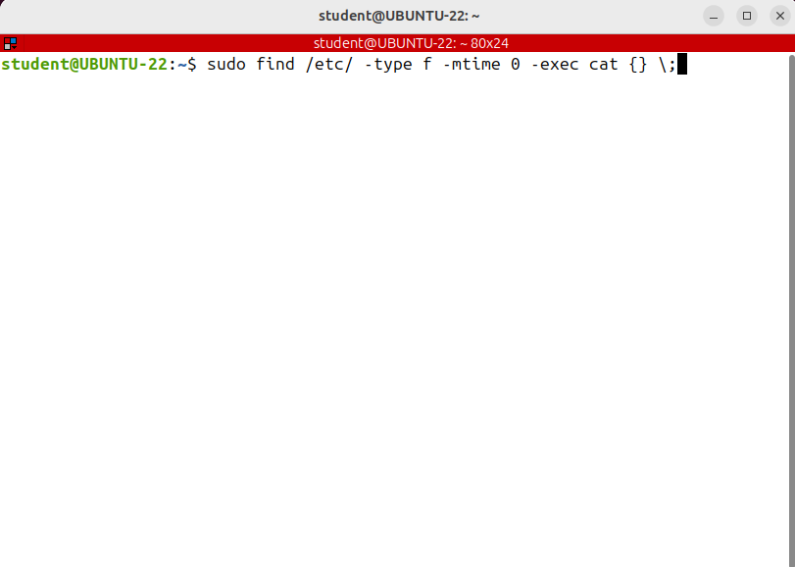
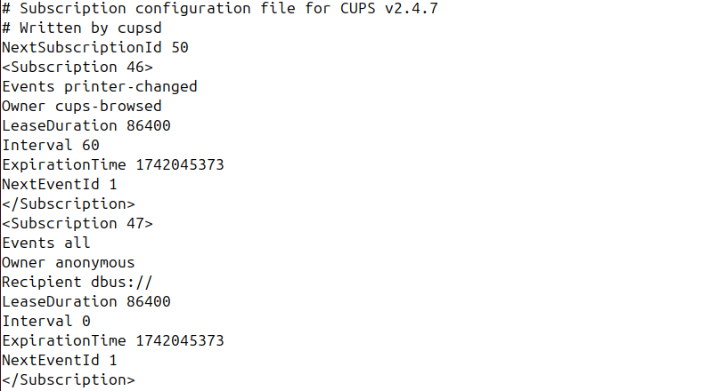
Find and Exec
Sometimes you want to operate or execute a command on the files that are found.
This is really useful.
There’s the -exec option that does that.
I want to back up or make a copy of all configuration files from /etc that were modified in the last week.
There is also the - OK option, which does the same is -exec, but interactively as it asks the user first. If the user agrees, it runs the command that follows.
Otherwise it just returns false.

Slide 8
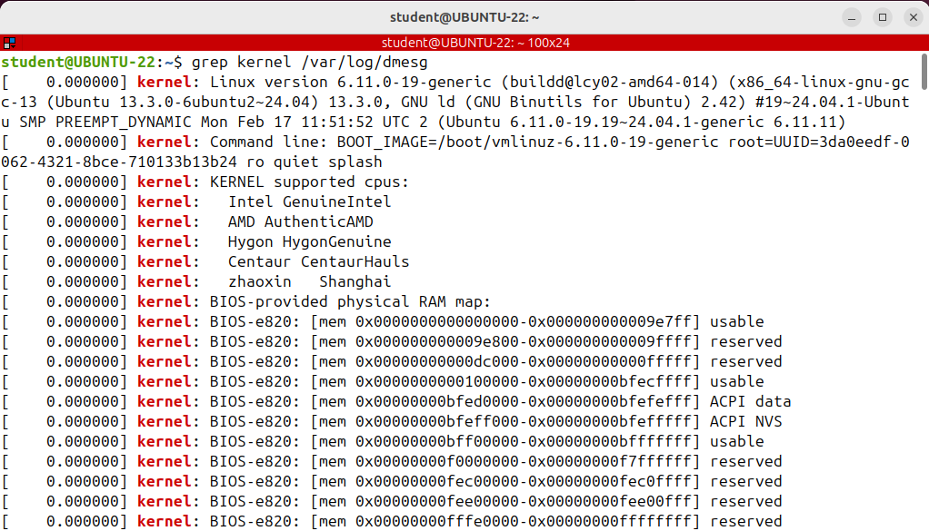
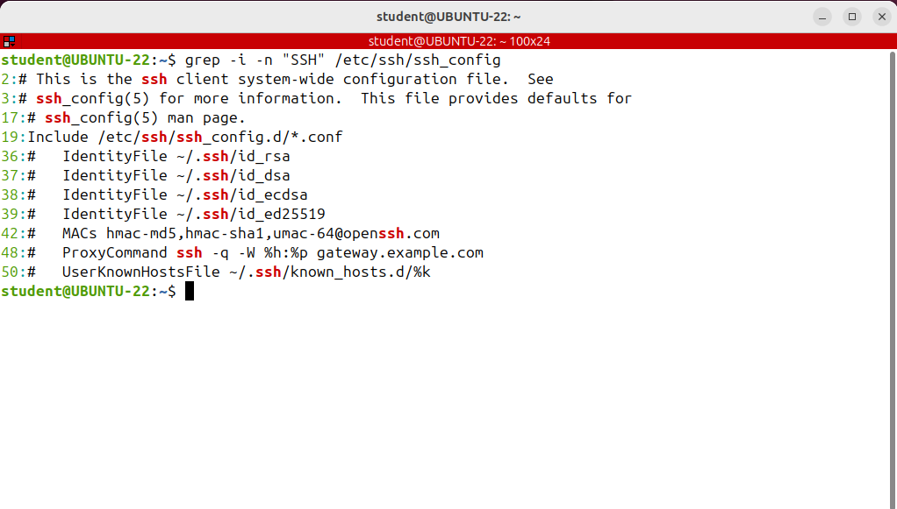
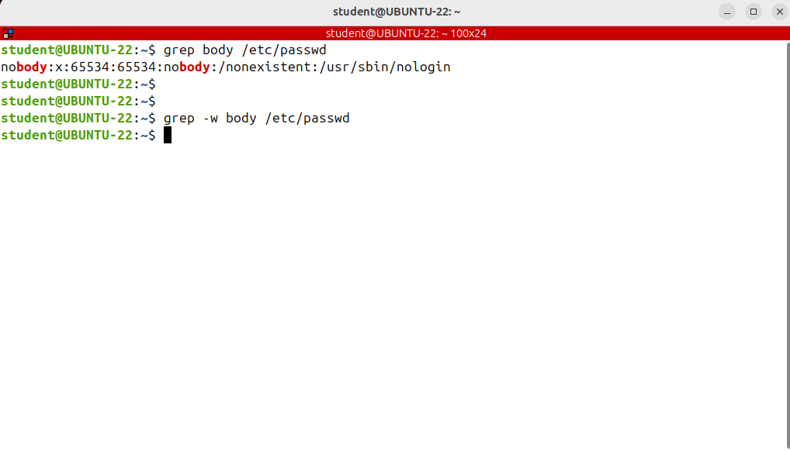
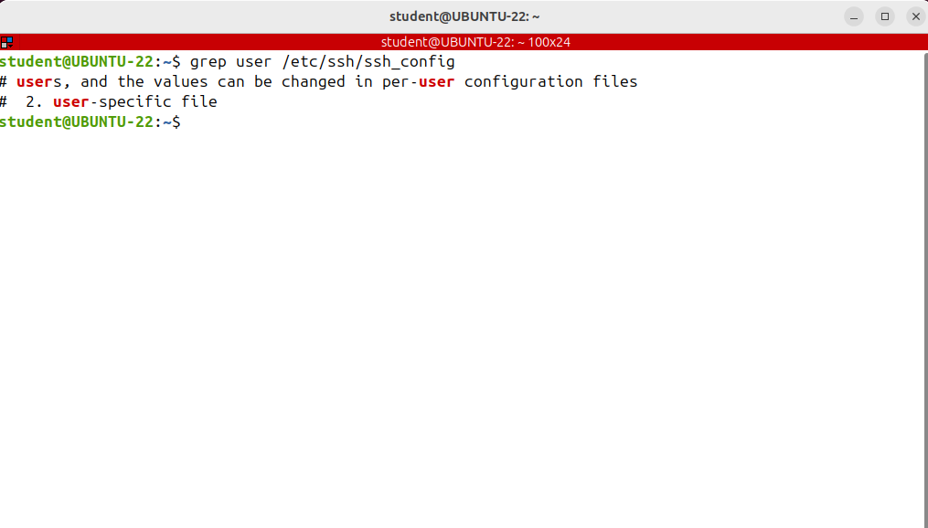
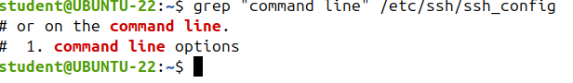
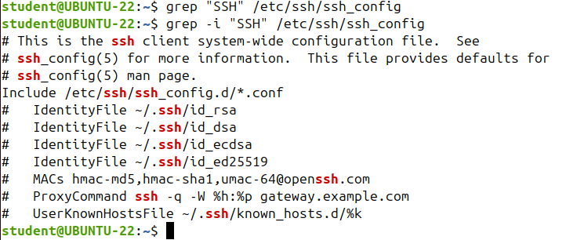
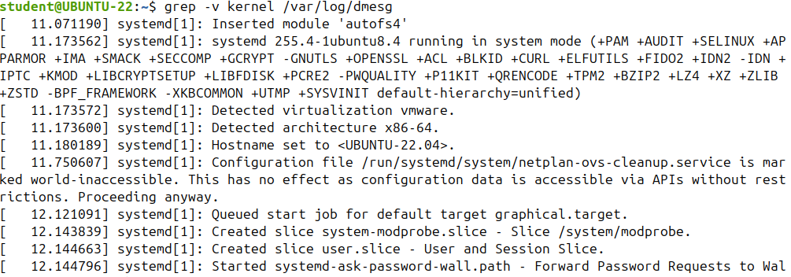
Searching for String Patterns in Text Files (grep)
it found all the lines that contain the string “kernel”.
How to search for a string pattern in a text file?.
This is especially useful because the Linux configuration and log files are of type text and is common to search for a specific option, message or error.
Grep is one of the most useful Linux commands,
The grep command searches in a text file or output of another command for a pattern referenced to as
a regular expression and prints out all lines that contain the pattern.
WHOLE WORDS
it found all the lines that NOT contain the string “kernel”.

Slide 9
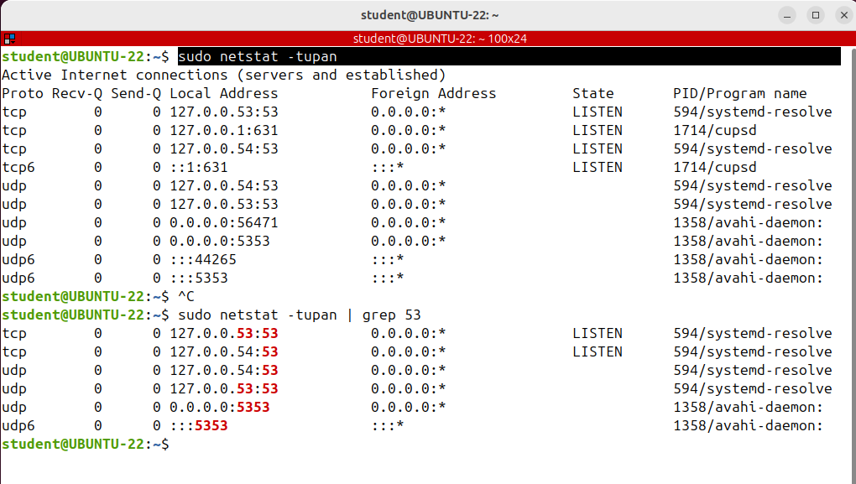
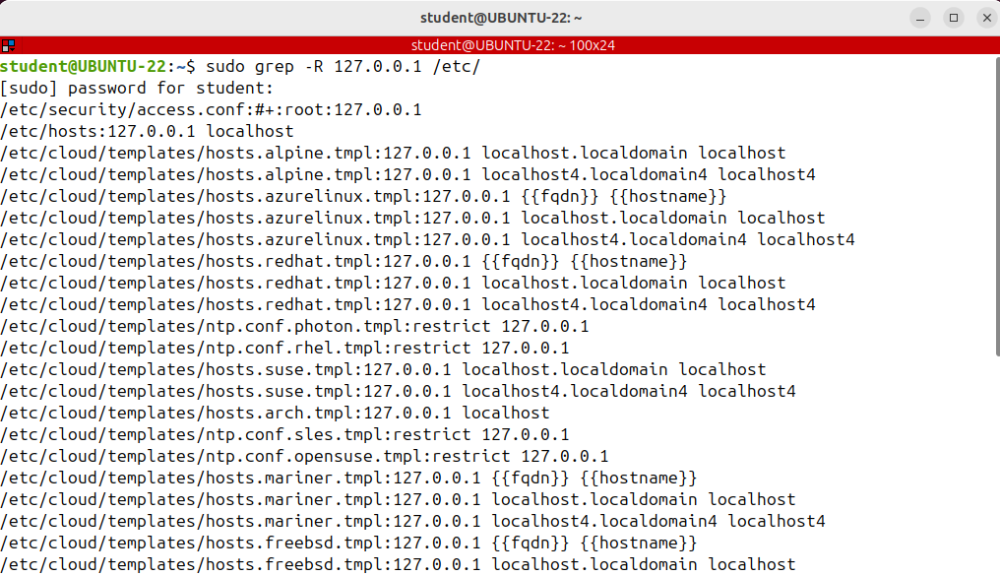
Searching for String Patterns in Text Files (grep)
I want tell to grep to go recursively in ETC directory and search for the pattern in every text file in that directory and all its subdirectories.
You need to use –R option
Another common example is to check what program is listening on a specific port.
To display all ports Run netstat with some options.

Slide 10
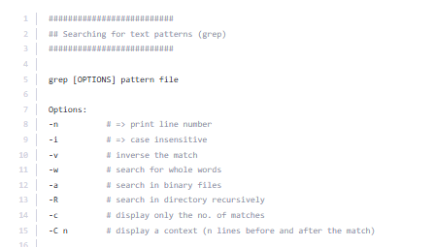
COMMAND grep

Slide 11
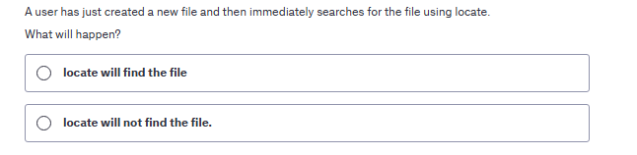
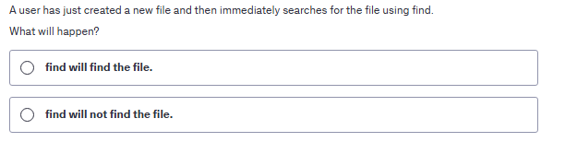
QUIZ TIME

Slide 12
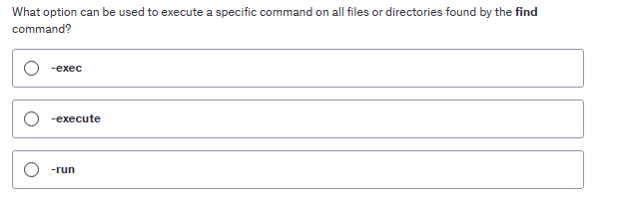
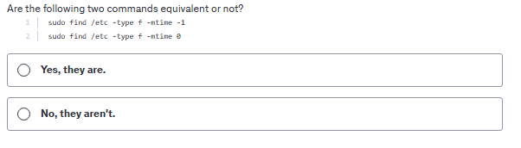
QUIZ TIME

Slide 13
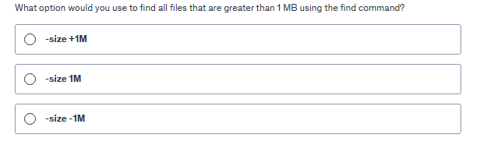
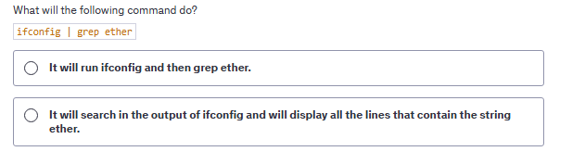
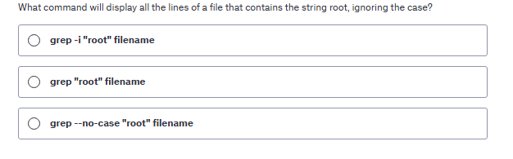
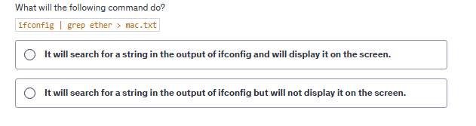
QUIZ TIME

Slide 14
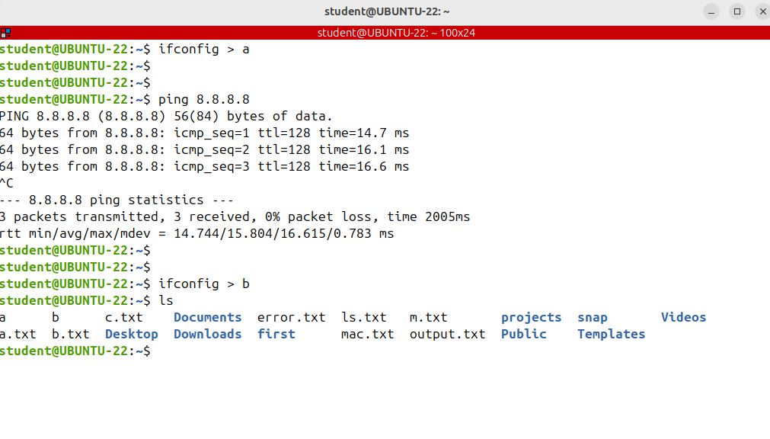
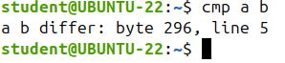
Comparing Files (cmp, diff, sha256)
We have different ways of comparing files contents.
This is especially useful when you want to compare either the output of the same command at different moments or the differences between a back up configuration file and the one currently used by the system.
Let's take a look at the first example.
To see if there was any difference between the two runs of the command, I can compare the files contents.
If you only want to know if there is a difference run the cmp command
If files are identical, no message is displayed.

Slide 15
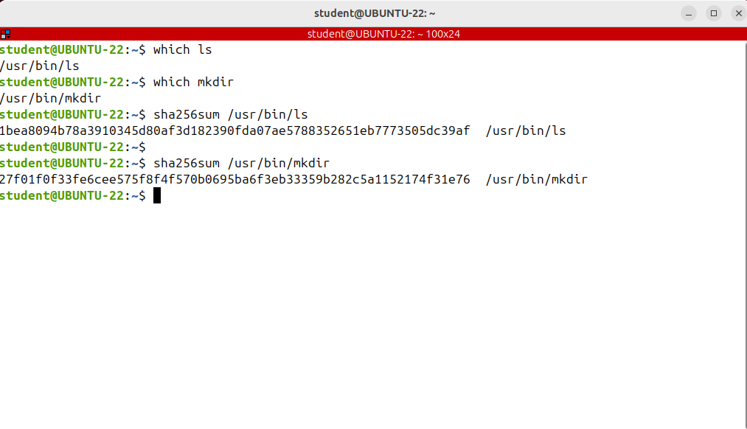
Find and Exec
To compare 2 binary files to see if they are identical iwe need to calculate and compare their hash.
The hash is a unique cryptographic id for each file.

Slide 16
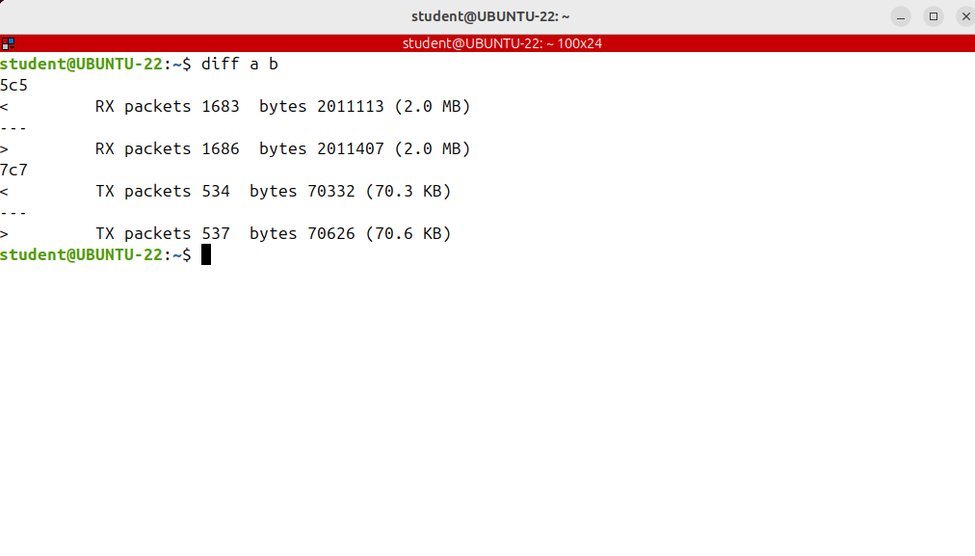
Comparing Files (cmp, diff, sha256)
if you want to go deeper and see exactly how they differ, you should run the diff command
It's used only for text files.

Slide 17
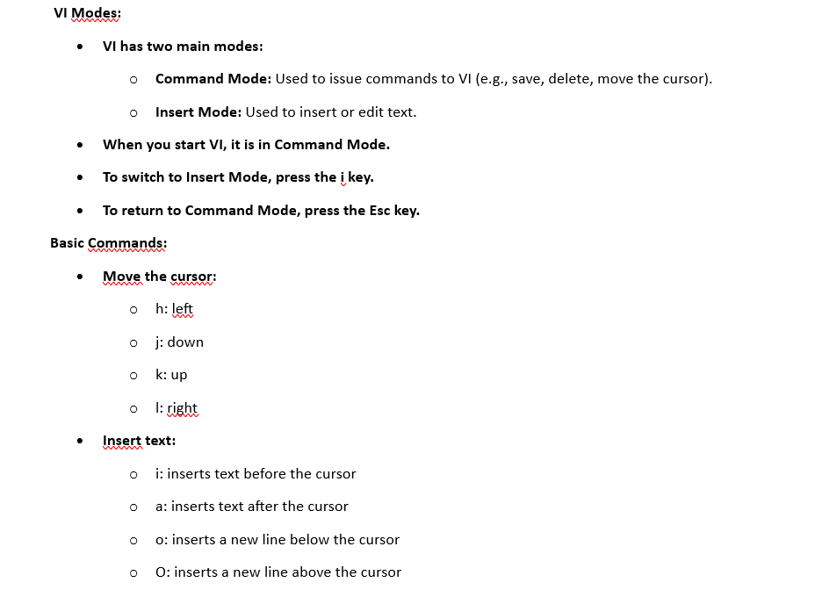
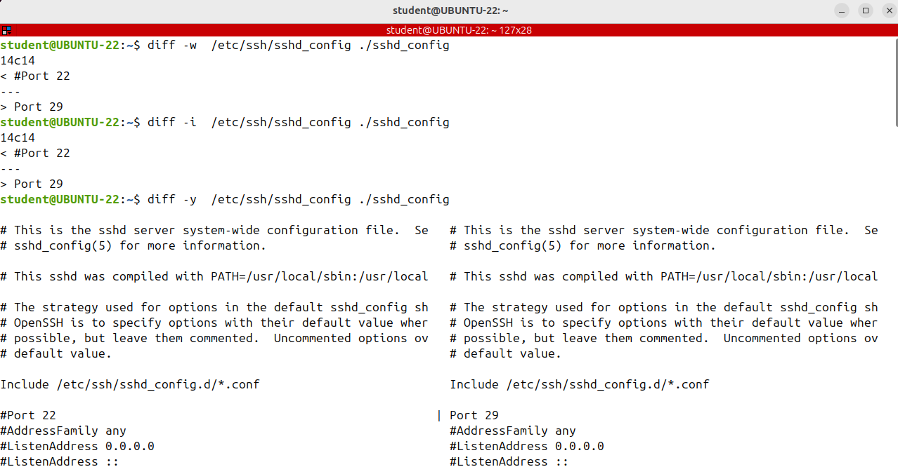
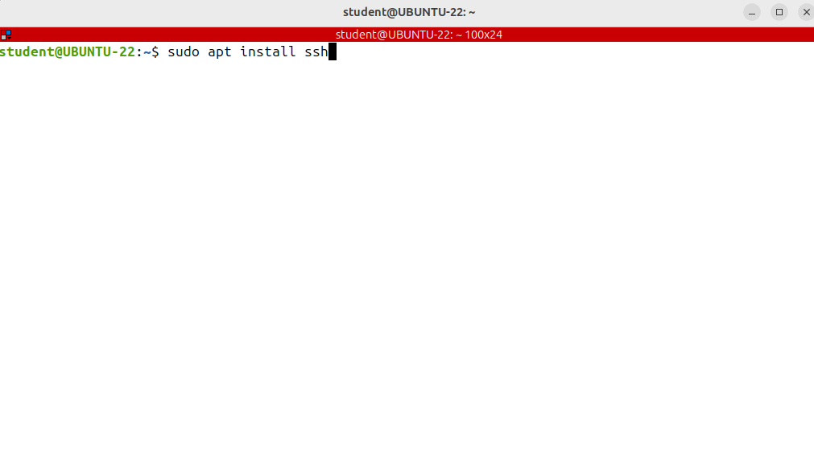













Comparing Files (cmp, diff, sha256)
Let's take another look of the output of the diff command.
We need to install the openssh server or daemon because we’ll need it anyway later
Ignore white spaces
Ignore case
for a more detailed comparison.
Suppose a new bug which is a programming error was discovered. The solution to make things right is the
developer to change the source code .
Instead of releasing an entire program, the developer releases only a patch, which is in fact a file
that contains the differences between the file that has the bug and the file where the bug was solved.
display the entire file's contents on 2 column side by side indicating the differences.
The diff command helps us make the files identical and indicates exactly what should be done.
This is used by the patch command to patch a program that has a bug.
We want to copy the configuration file of the ssh demon in the current working directory
I'm opening the file with VI and changing the port option. Alternatively you can edit the file using the gedit, the graphical editor
available on Ubuntu.

Slide 18


VIM

Slide 19


Compressing and Archiving Files and Directories (tar, gzip)
We want to learn how to archive and compress files and directories in Linux.
Tar is the most widely used command to create compressed archive files that can be moved easily from one disk or machine to another.
This command has a large number of options, but you need to remember only a few of them so we can quickly work with it.
Most used options:
c, which creates an archive
x, which extracts the archives
t, which displays the contents of the archives or its table of contents.
Tar is a complex tool used to both archive and compress files as well as extract the resulting archives.
-c means create an archive
-z tells tar to also compress the archive using gzip or gnuzip compression.
-v Verbose
-f file name ( it’s mandatory to specify the archive file name after the option f.)

Slide 20




Compressing and Archiving Files and Directories (tar, gzip)
Another useful compression algorithm is bzip2 which creates smaller files, but at the cost of speed.
However, nowdays computers are so fast that most users won't notice much of a difference between the between the times taken by gzip or bzip2 to compress a group of files. To bzip2 instead of gzip, simply use the `j` option instead of `z`.

Slide 21





Compressing and Archiving Files and Directories (tar, gzip)
Once you have an archive, you can extract it with the same command, using –x option
If you want to extract an archive into another directory use -C option and the destination directory

Slide 22

Compressing and Archiving Files and Directories (tar, gzip)
To see the contents of an archive use the -t option, which comes from the table of contents
The examples shown are extremely useful because the /etc directory contains the
configuration files of the entire system. In my opinion, it's mandatory to have a back up of this directories so it can be restored if after an update or change, something goes wrong.

Slide 23


Compressing and Archiving Files and Directories (tar, gzip)
If you want to have versions, which are backups made in different days, then you need to insert the date into the back up filename.
Please see next example:

